Slide 1
Plug-in Electric Vehicles
David Ellis
May 20, 2010
AABE National Conference

Slide 2
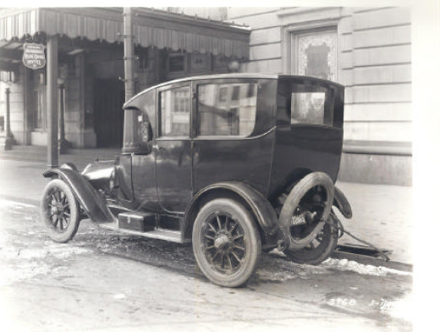

In 1914, Detroit was the first American city to use electric taxi cabs
Detroit’s first electric taxi accumulated more than 46,000 miles in its first two years of operation.
Note the curb-side charging port and main charging stations.

Slide 3
Electric drive technologies
Today
Plug-in Electric Vehicles (PEV)
Internal Combustion Engine (ICE)
Hybrid Electric Vehicle (HEV)
Plug-in Hybrid Electric Vehicle (PHEV)
Extended Range Electric Vehicle (EREV)
Battery Electric Vehicle
(BEV)
Differential
Differential
Differential
Motor
Motor
Mechanical Coupling
Mechanical Coupling
Transmission
Batteries
Engine
Transmission
Motor
Transmission
Motor
Batteries
Generator
Engine
Batteries
Batteries
Engine
Engine
Miles
Electric only: 10-20 ~40 100+
Larger battery and less emissions

Slide 4
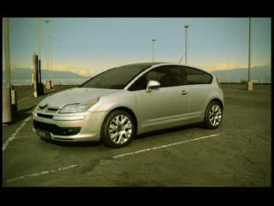
Has technology gone to far?

Slide 5
Electric drive technologies and annual electricity consumption
Annual Electricity Usage per Vehicle*
(kWh)
75% of Americans drive less than 40 miles on their daily commute
40 miles electric only - achieves similar GHG reduction as BEV
- Limited need for public charging
BEVs will require faster charge rates and more daytime charging to address range “anxiety”
- Needs public charging infrastructure
* Assumes a vehicle drives 12,500 miles / day, PHEV and EREV electric usage varies depending on drive characteristics, Chevy Volt-type vehicle at 5 mi/kWh

Slide 6
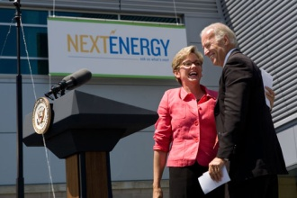


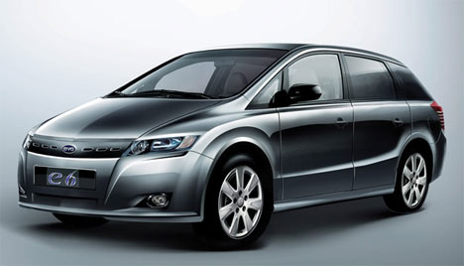


In addition to technology advances, multiple factors are aligning to support a successful launch of PEVs
U.S.A.
Rest of World
Policy
$2.4 Billion in U.S. stimulus dollars directed at advanced automotive batteries
European Union target of 95 grams of CO₂/km by 2020
=> 60 mpg
Climate
Significant activity in Washington on federal climate legislation
China’s commitment to building 500,000/year hybrid and electric vehicles by 2012
Energy Security
Push for a domestic fuel source and fear of the return of high gas prices
Urban smog in emerging mega-cities

Slide 7
Plug-ins have a big fuel cost advantage …
but for now, disadvantaged on purchase price
US example
Fuel Cost Comparison*
($/Mile)
… but BIG upfront premium today
$12,500 - $17,500 fuel savings over 10 years*
~$15,000 premium over regular car reduced by $7,500 tax credit
* Gallon of gasoline equivalent price computed comparing ICE mileage of 26 mpg to PEV mileage of 5 mi/kWh at $0.10/kWh, 12,500 miles per year, undiscounted

Slide 8
Electricity drive reduces GHG emissions and our addiction to imported oil
Freedom from petroleum: electricity a domestic resource
350
Future
ICE
Hybrid
Coal
Natural Gas
Nuclear, Wind, Solar, etc.
Gasoline
Electricity (by source)
* 204 lb/MMBtu CO2 emissions rate (no carbon capture), 9,500 heat rate coal plant, 7,500 heat rate natural gas plant, ICE engine at 26 mpg, Hybrid drivetrain between 30-45 mpg, electric motor at 5 mi/kWh
Source: Argonne National Labs GREET Model, DTE Team Analysis

Slide 9
Infrastructure in place for broad PEV adoption
ILLUSTRATIVE
Impact of PEV on Typical Summer Load Profile (Ideal Case)*
MW
10% market share**
* PHEV is likely to also contribute to increased load during peak hours. Illustrative example of electric utility load – similar to Detroit Edison
** Estimated 600,000 cars and light trucks (does not include diesel trucks, buses, etc), 12,500 miles per year, 3.0 mi/kWh average efficiency, 75% electric operation
Source: DTE analyses, EPRI/NRDC Report

Slide 10
Uncontrolled charging could lead to localized disruptions if not properly managed
Load shape for warm summer day – adding 3 PEVs to a neighborhood
Potential problems
  Voltage dips (dimming lights, damage to expensive electronics)
  Service interruption
  Transformer failure
Measures to address these issues
  On-vehicle charging control
  (time/date control)
  Utility notified at time of PEV purchase
  SmartGrid technology
25 kVA Transformer with Uncontrolled PEV Load*
Summer Load
3 PEV @ 1.4 kW
3 PEV @ 3.3 kW
Peak Capacity
Design Capacity`
* 8-12 smaller, older homes per 25 kVA circuit. Most homes without central AC.

Slide 11
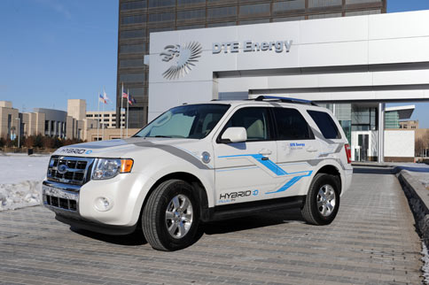
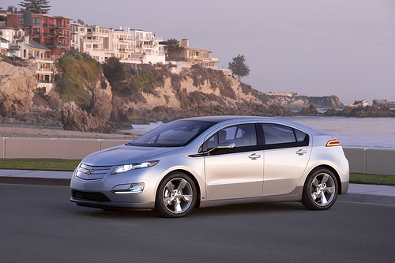
DTE is working with Ford, GM and Chrysler on real-world testing
Testing is focused on:
  Battery technology
  Vehicle systems
  Customer usage
  Grid infrastructure
2009 Ford Escape plug-in hybrid electric vehicle
2011 Chevy Volt

